Slide 1

Rob Ross
VP Business Development
rob@xamarin.com
Enterprise
Mobility
101
Notes:
1

Slide 2
Questions we’ll cover
What is the Enterprise Mobility Industry?
What is the Mobile Developer Value Chain?
What is a Mobile Backend as a Service?
What is Mobile Security?
Who are the major players?
What does Xamarin Business Development actually do?
What do I do if I have an account that needs a tech partner?
Where can I go to learn more?
Notes:
2 -

Slide 3

Unprecedented Pace of Change
52% of the Fortune 500
since 2000 are gone
1B
50B
Millennials
transforming customer demands & workplace
Internet connected devices by 2020
people in social networks
Notes:
2 -

Slide 4










































































































































Notes:
2 - These are all Xamarin customers. Where will they be in 5 years? in 10 years? They are building their future today.
They’re across the board in their level of enterprise mobile maturity.

Slide 5
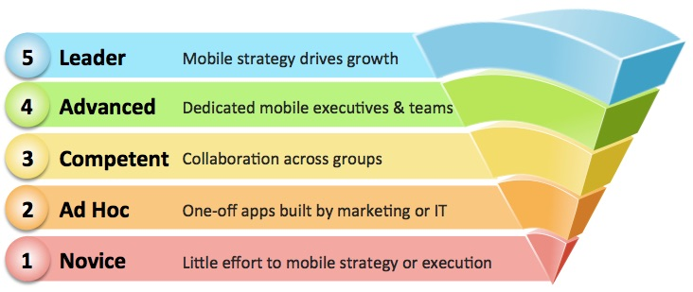
Enterprise Mobile Maturity Index
Notes:
3 - Some companies get it, others are behind.
If the CEO is personally driving mobile transformation for customers – and across senior management and employees – the company is a Leader.

Slide 6


How do we make next generation mobile apps more engaging
and transactional?
Notes:
1 - Leaders are not just answering this question, they’re delivering highly innovative solutions

Slide 7


Mobilizing
the enterprise requires a
mobile-first foundation
Notes:
1 - Mobilizing the enterprise requires a mobile-first foundation

Slide 8





Not an easy journey
RICH
INTERACTIVE
web
applications
TRUSTED
CONTEXTUAL
mobile
apps
Notes:
2 - What we’re really talking about are new contextual & technical paradigms.
It’s not just about 1 new wave of technology or implementing a specific product, it’s about understanding new concepts and anticipating an era in which there’s wave after wave after wave.

Slide 9
The Strands of Mobile DNA
Offline
Operations
Actionable
Notifications
My
Mobile
App
Contextual
Awareness
Enterprise APIs
App
Lifecycle
Activity
Insights
Notes:
3 - These are the concepts core to mobile innovation
Offline Operations – seamless transition between connected & disconnected, apps & backend
Notifications – beyond push notifications into secure data exchange, delivery confirmation, custom payloads
2. Enterprise APIs –sophisticated authentication, single sign-on, secure data transfer
3. Activity Insights – using mobile activity metrics to feed big data and analytics
4. App Lifecycle – app distribution, performance & crash, user management
5. Contextual Awareness – using context to increase capabilities based on location, time, date, personal activity & sensors, etc.
The companies that build these concepts into the fabric of their business will thrive
This presents a major market opportunity in what we call enterprise mobility.

Slide 10






















What is the Enterprise Mobility Market?
Mobile Devices
Mobile OS
Telecom, Internet & Data
Business Apps
(ERP, CRM, BI, HCM)
Mobile Cloud Infrastructure
Enterprise Mobility Management
Mobile Dev Tools
& Services
Professional
Services
Notes:
3 – The enterprise mobility is a collection of hardware and software services that bring customer and employee to a new dimension.

Slide 11

2017 Market Size
Enterprise Mobility
$174B
Mobile Business Apps
$53B
Notes:
1- And it’s a large market!

Slide 12
What is “The Cloud”?
Notes:
1- The evolution of Amazon really tells the story of why (and how) the cloud came to be so important.

Slide 13







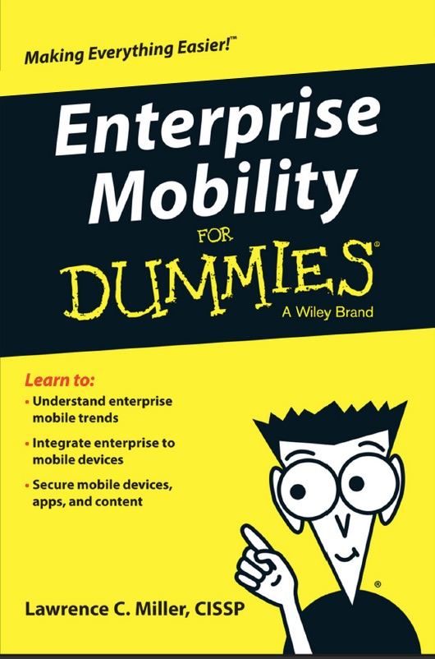

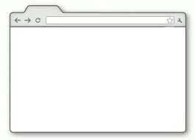
The Evolution of Amazon
Services
Company
Shopping

Slide 14

Gartner
Amazon’s cloud is
10x bigger than its next
14 competitors, combined
Notes:
Gartner is one of the top two technology industry analyst firms. They’re like the bible of tech research. Read this. AWS is HUGE!

Slide 15
Why is the Cloud so Attractive?
Little to no capital
Massively
scalable
Shared
resources
Device
independent
Location
independent
Notes:
2 – It is the lynch-pin that ensures the sustainability and growth of companies into future.

Slide 16
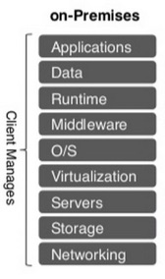
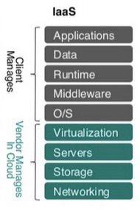
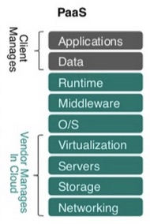
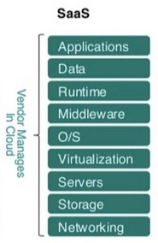
Cloud Services 101
Notes:
2 – Amazon build a cloud model that has expanded into other “as a service” market segments, like Infrastructure as a Service, Platform as a Service & Software as a service

Slide 17














Who are the players?
Software as a Service | SaaS | applications in a browser
Platform as a Service | PaaS | managed application infrastructure
Infrastructure as a Service | IaaS | virtualized servers with computing & database services
Notes:
2 –
MBaaS – is a way for devs to link their applications to a backend and all backend APIs (also offers features like push, user management, etc.)
SaaS – is an on-demand delivery model for providing applications and services to customers (hosted in cloud and used through a browser)
PaaS – provides ready-to-use libraries, tools and services such as databases, security, user management, monitoring and analytics, which can be easily “baked in”
IaaS – is a service model for delivering on-demand infrastructure. It provides the ability to access, manage, and monitor physical and virtual resources like storage and databases

Slide 18
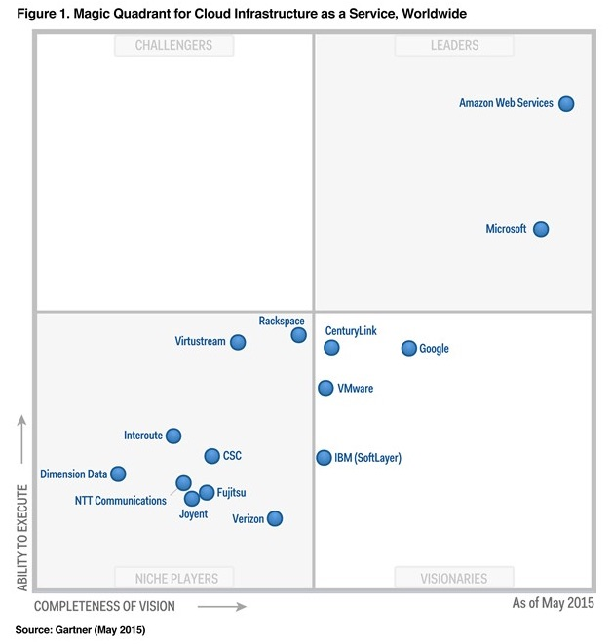
Gartner Magic Quadrant – IaaS
Notes:
1 – Do you know who Gartner is?– they rank market segment like IaaS in an annual chart called the Gartner Magic Quadrant.

Slide 19

End-to-End Enterprise Mobile Strategy
Every enterprise app needs
Consumer-grade frontend
Enterprise-grade backend
Software Development Lifecycle

Slide 20

Mobile Enables Cloud Growth

Slide 21













































Mobile Development Value Chain
Prototype
Prototype
Build
Build
Developer Services
Developer Services
API Management
API Management
User Interface
Cloud/Enterprise
Continuous Integration
Test
User Interface
Cloud/Enterprise
Continuous Integration
Test
Xamarin.Forms
Team
Foundation
Server
Social
Social
Identity
Identity
User Analytics
User Analytics
Performance
Performance
Payments
Payments
Notifications
Notifications
Ads
Ads
Security
Security

Slide 22
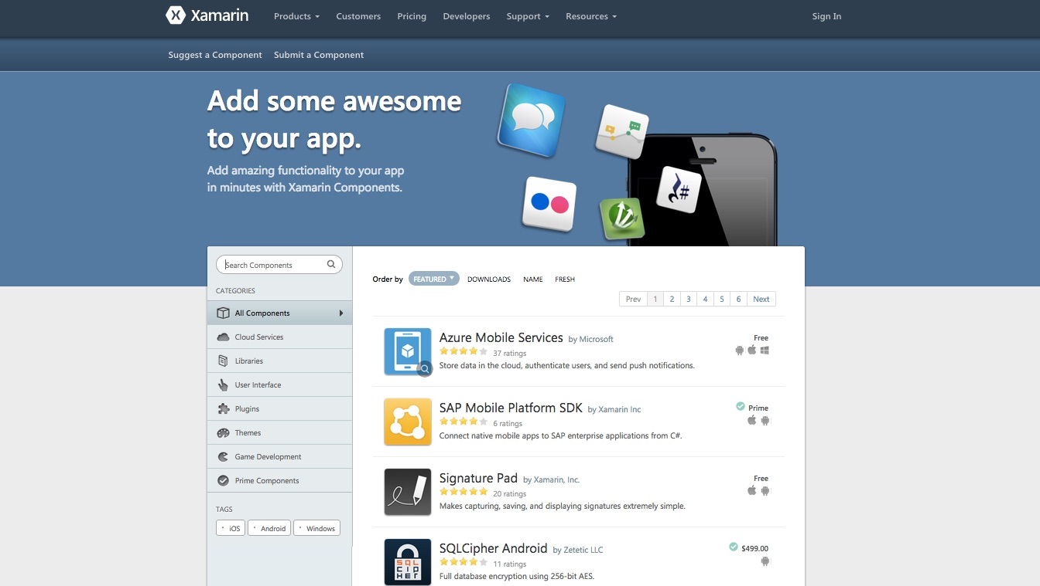
Xamarin Component Store

Slide 23

Enterprise Mobility Framework
Mobile App IDE
Enterprise
Mobility
Management
Mobile
Security
Mobile Development Framework
Mobile Backend as a Service
API Management
Enterprise
Management
Enterprise
Security
Enterprise
Systems
SaaS

Slide 24















Mobile App IDE
Mobile App IDE
Enterprise
Mobility
Management
Mobile
Security
Mobile Development Framework
Mobile Backend as a Service
API Management
Enterprise
Management
Enterprise
Security
Enterprise
Systems
SaaS
IntelliJ
IDE with designer, code editor, debugger
Build Native or HTML5/Javascript
Integrates with version control systems

Slide 25









Mobile Development Framework
Mobile App IDE
Enterprise
Mobility
Management
Mobile
Security
Mobile Development Framework
Mobile Backend as a Service
API Management
Enterprise
Management
Enterprise
Security
Enterprise
Systems
SaaS
Compile native, hybrid or HTML5
Constant changes for new OS versions

Slide 26







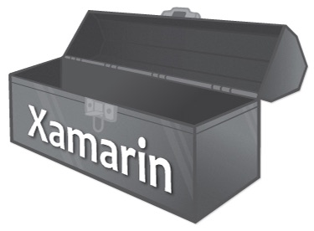


Components
Component Store
Custom Bindings
Runtime
Engine
Xamarin.iOS
Xamarin.Android
IDE
Xamarin Studio
Visual Studio Integration
Framework
.NET

Slide 27






Mobile Backend as a Service (MBaaS)
Mobile App IDE
Enterprise
Mobility
Management
Mobile
Security
Mobile Development Framework
Mobile Backend as a Service
API Management
Enterprise
Management
Enterprise
Security
Enterprise
Systems
SaaS
“Turn on” mobile backend in the cloud
Auth, storage, notifications, location, sync
Enterprise & 3rd party integrations
Analytics, enterprise app store/distribution

Slide 28








Enterprise Mobility Management (EMM)
Mobile App IDE
Enterprise
Mobility
Management
Mobile
Security
Mobile Development Framework
MBaaS
Mobile
Middleware
API Management
Enterprise
Management
Enterprise
Security
Enterprise
Systems
SaaS
Mobile Device Management (MDM)
Mobile App Management (MAM)
Mobile Content Management (MCM)
Enterprise App Store, Secure Container

Slide 29
What is Enterprise Mobility Management?
Mobile Device Management MDM
Set & reset passwords Install/delete apps Remote/selective device wipe Remote lock Set VPN, Wi-Fi settings Enable/disable Wi-Fi, Bluetooth, carrier data, camera
Mobile App Management MAM
Self-service app delivery Enterprise app store Containerization Enable/disable copy/paste Restrict app file access App usage monitoring Apple volume purchase
Mobile Content Management MCM
Encrypted document container Secure email File server access Secure SharePoint access Enterprise Document Mgmt

Slide 30
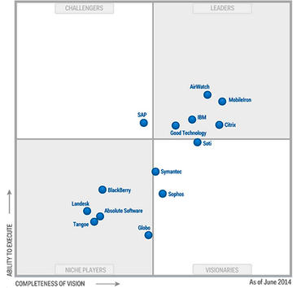
Gartner Magic Quadrant – EMM

Slide 31



API Management
Mobile App IDE
Enterprise
Mobility
Management
Mobile
Security
Mobile Development Framework
MBaaS
Mobile
Middleware
API Management
Enterprise
Management
Enterprise
Security
Enterprise
Systems
SaaS
Manage APIs for extended enterprise services
Cloud, on premise or hybrid deployment
Activity insight through reporting & analytics

Slide 32
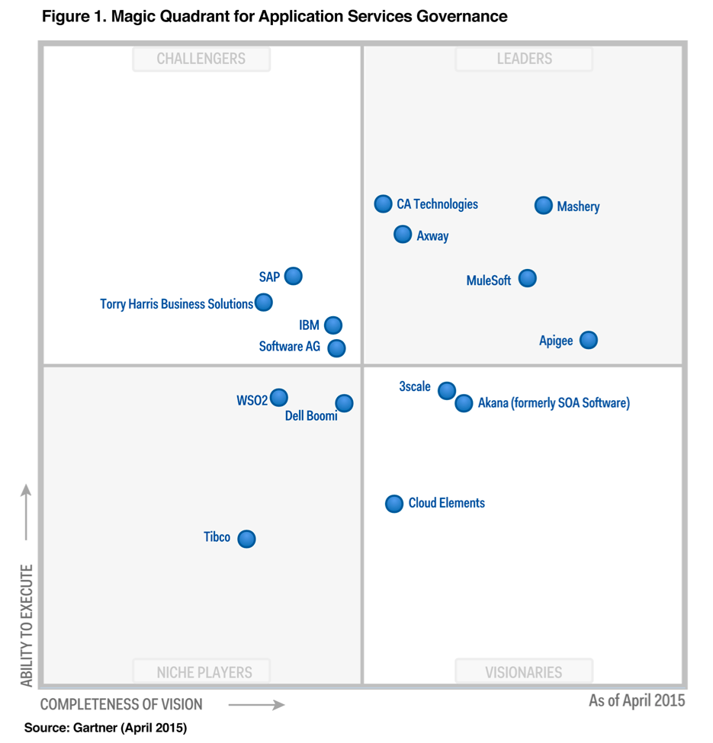
Gartner Magic Quadrant – APIs

Slide 33

Opportunity Expansion of our Ecosystem
Overlay
Continuous Integration
Design Tools, A/B Testing
User Analytics
Advanced Industry-specific
Value
Fulfilling the brand promise– “anything you can do in Objective-C, Java, or Swift, you can do with Xamarin”
Proactively meeting the needs of our enterprise customers
Strategic alliances & enhanced market perception
Increased customer-confidence accelerating sales potential
Expands Xamarin’s footprint across wider developer communities
Encourages adoption of Xamarin University, XTC, Insights
Backend Systems
MBaaS , PaaS
Mobile Platforms
Security
API Management Systems
Frontend Tools
UI Toolkits
Gaming
Readers
Device-specific integrations
Apps 360
Core Considerations
Why not open source all 3rd party integrations?
Which integrations areas have optimal impact to the Xamarin community?
Advanced APIs
Notifications
Communication
Mapping, Payments
Encryption, Authentication
Sync, Social, Ads

Slide 34
Business Development Goals
Leverage tech partnerships for strategic growth
Negotiate & manage strategic relationships
Grow component store supply & demand
Identify & create new revenue streams
Drive distribution of Xamarin products
Evaluate corporate development opportunities

Slide 35


Xamarin’s Enterprise Partnerships
The experiences your users expect.
The security and connections your organization requires.

Slide 38
Resources
Wikipedia: Mobile Enterprise MDM, MAM, MBaaS
ComputerWorld: MDM features and functions compared
Gartner Magic Quadrants (for EMM, MADP)

Slide 39
Thanks!

